Slide 1
Weekly Meeting Dec 08, 2023
Nuruzzaman Sakib
Department of Mechanical Engineering, University of Alabama, Tuscaloosa, AL

Slide 2
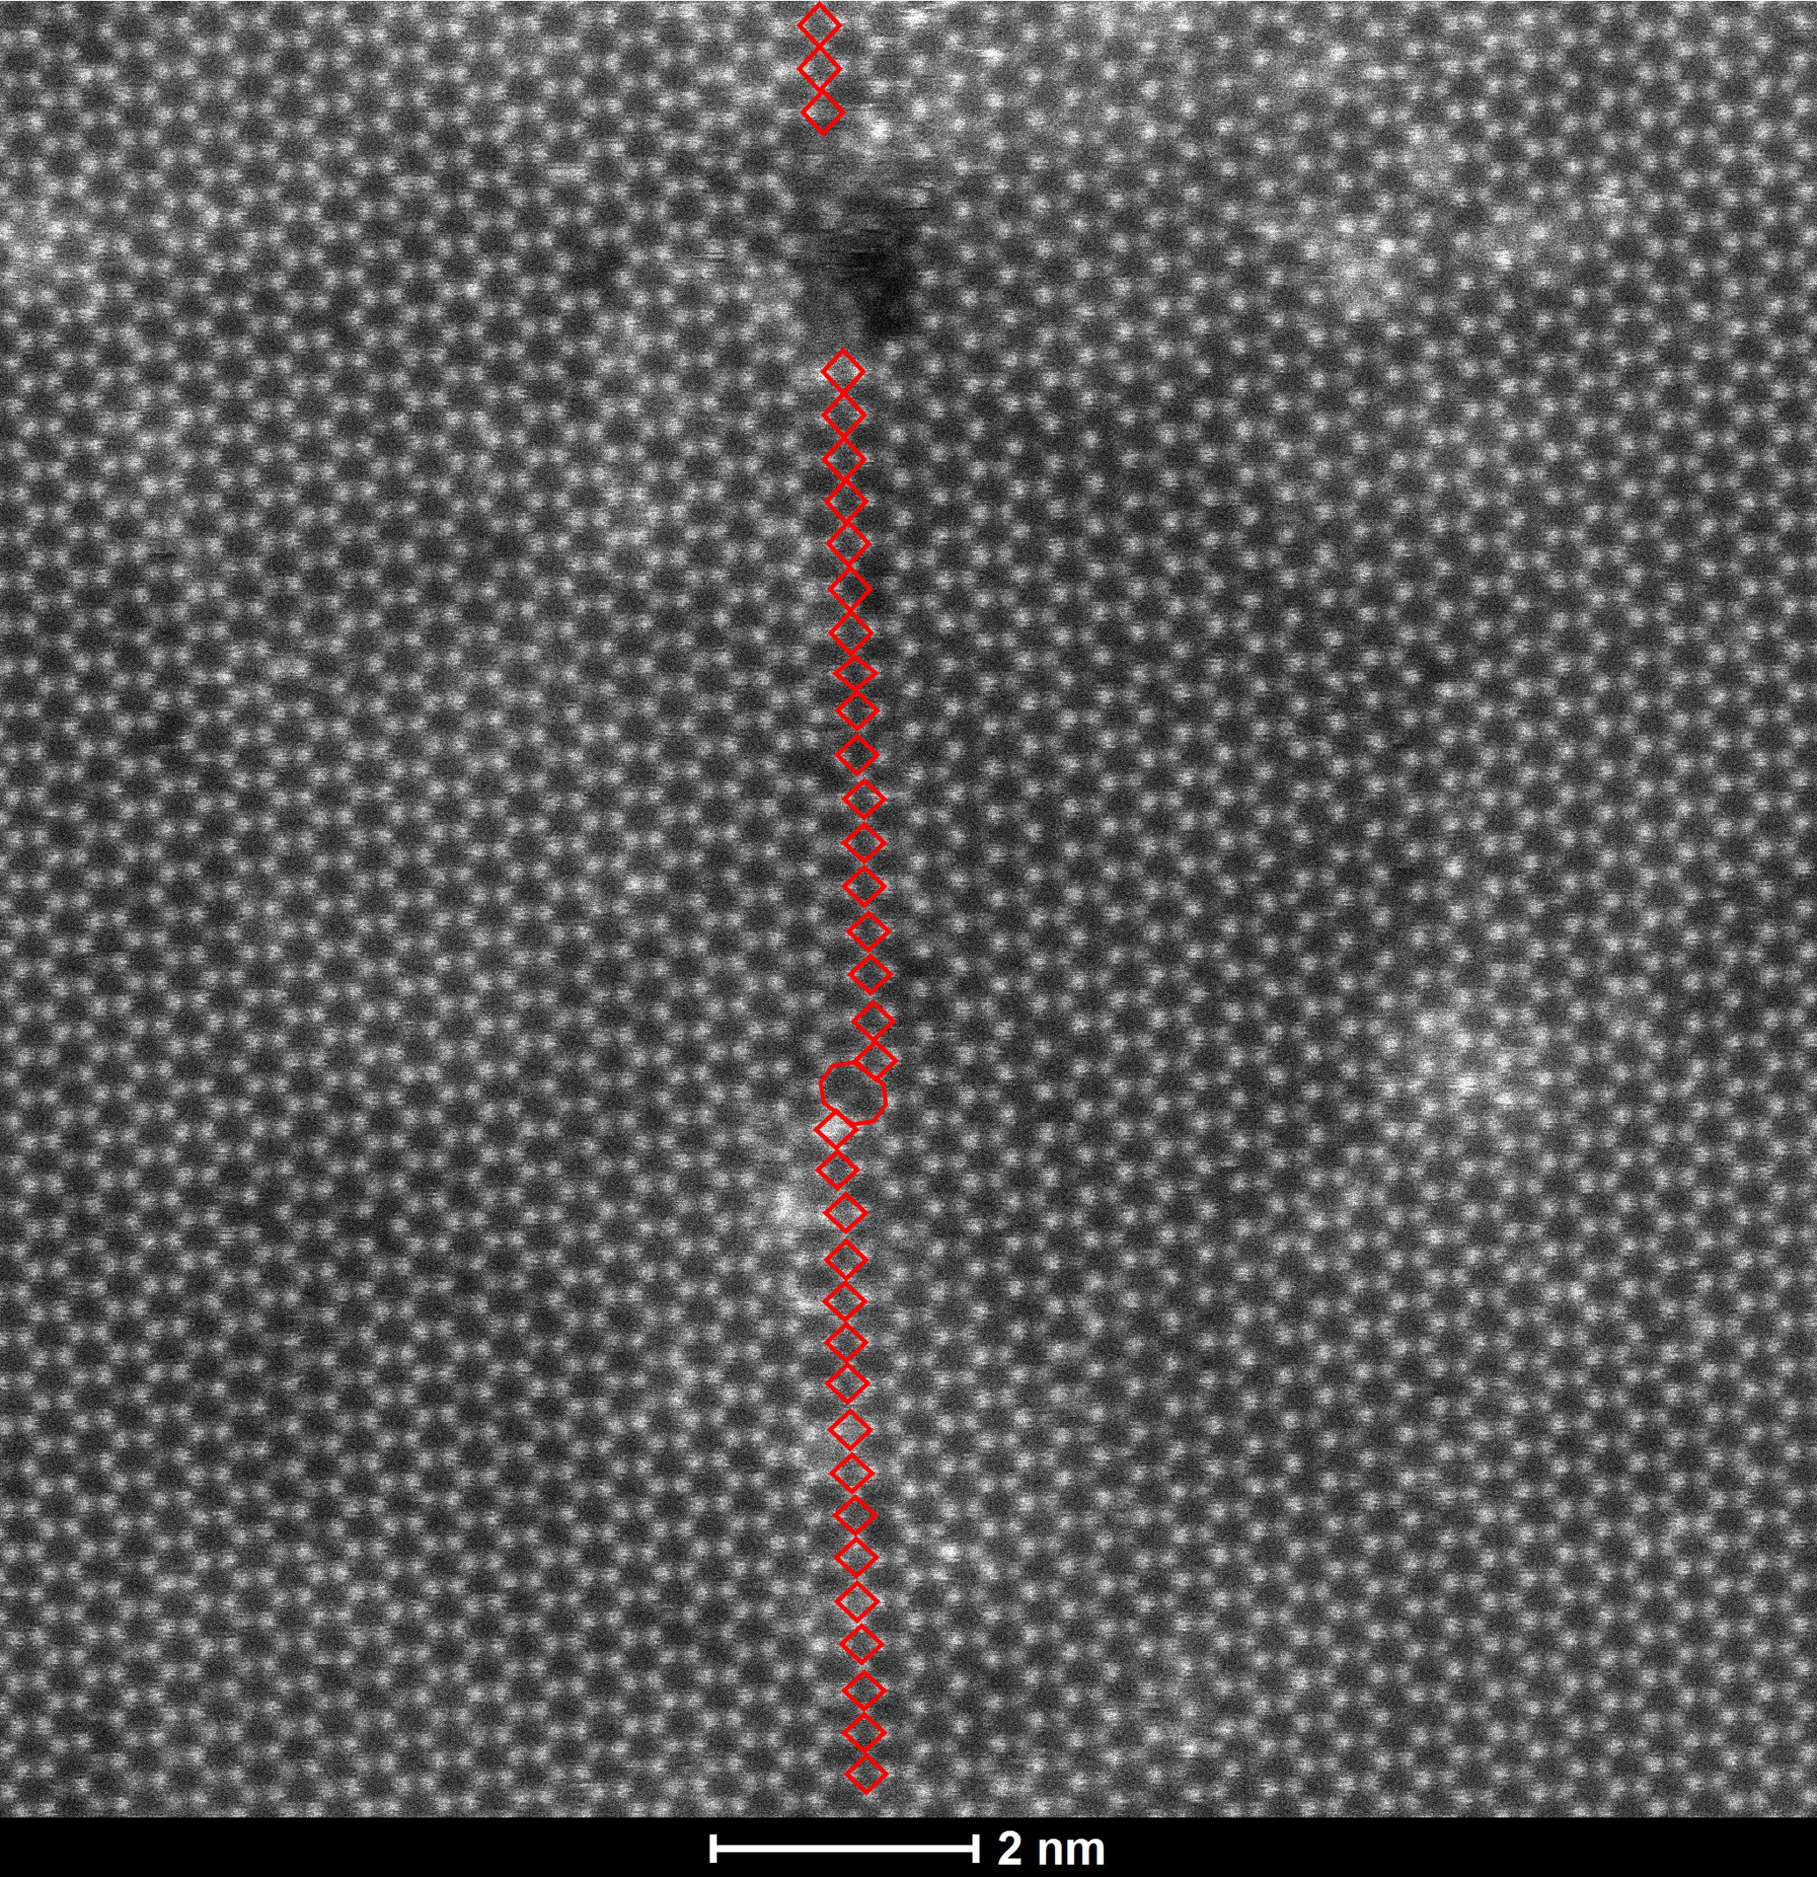
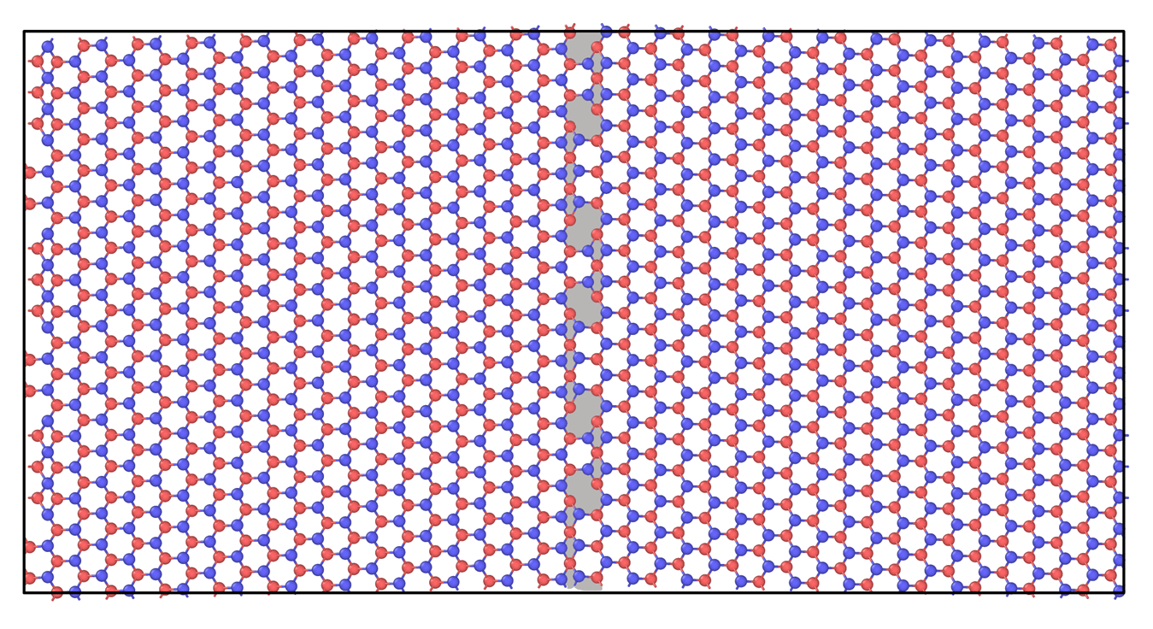
4-8 GBs
Tried to create this GBS with 4-8 defects

Slide 3
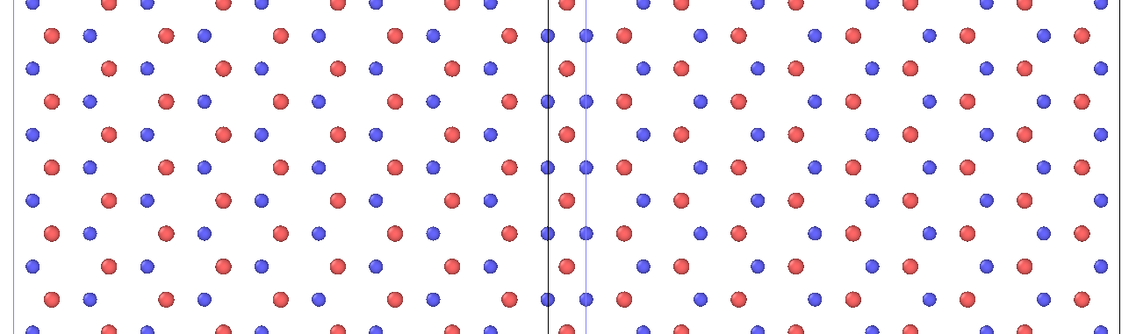
448448…GB

Slide 4
Periodicity Check along Y direction
Step 2

Slide 5
GB Line

Slide 6
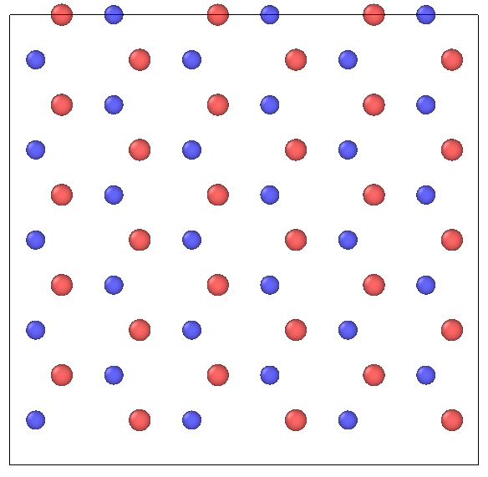
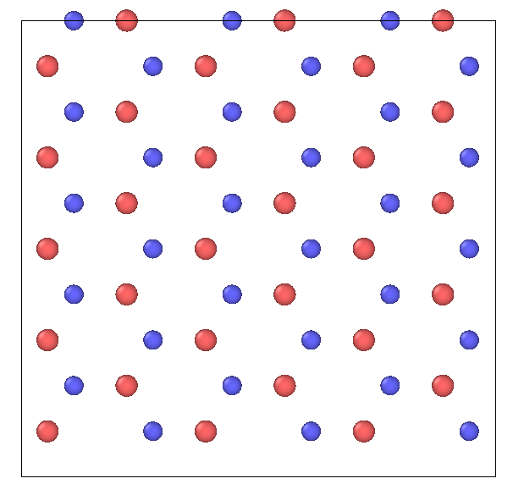
Left Right

Slide 7
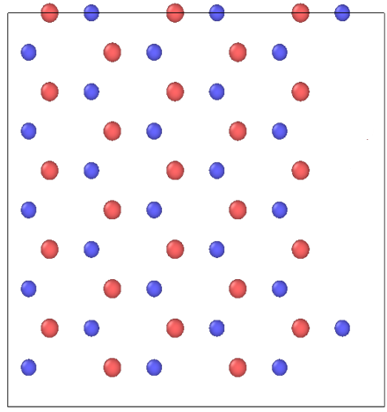
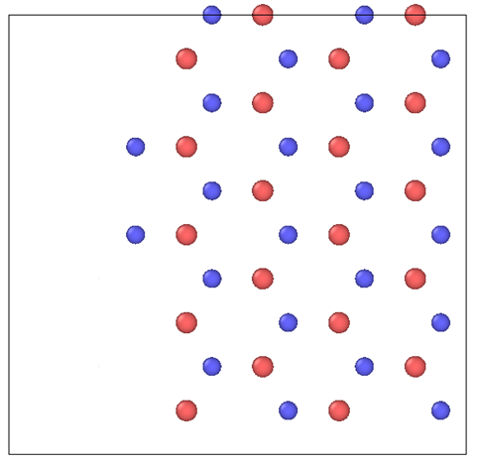
Left Right

Slide 8
Combine

Slide 9
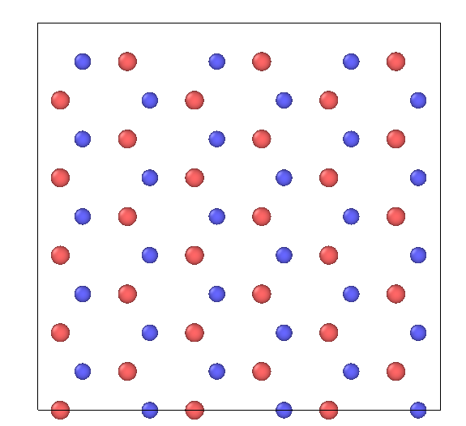
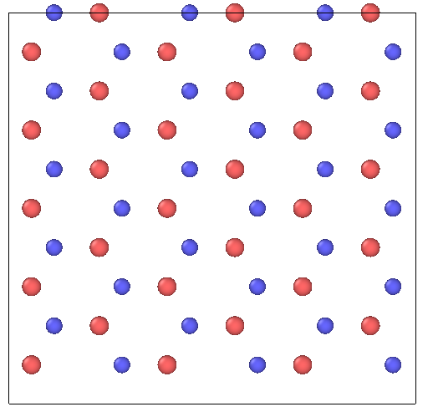
Both Boundary

Slide 10
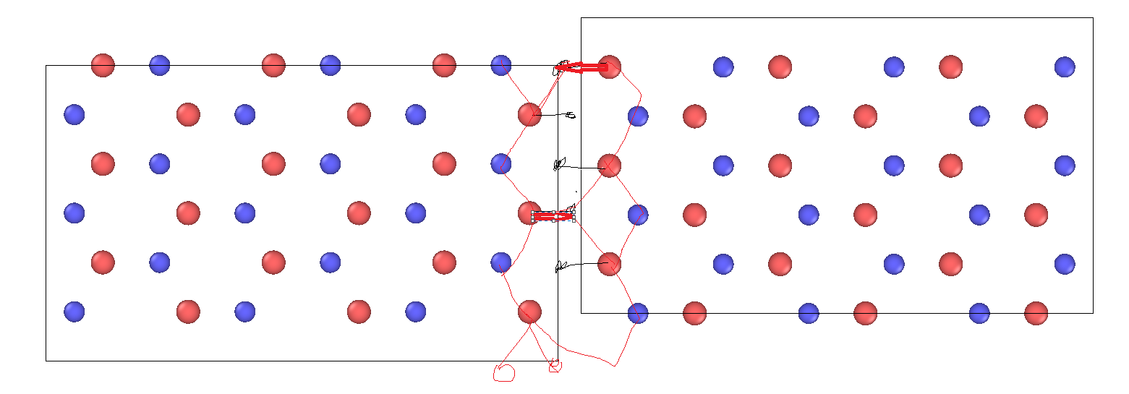
4-8-4-8

Slide 11
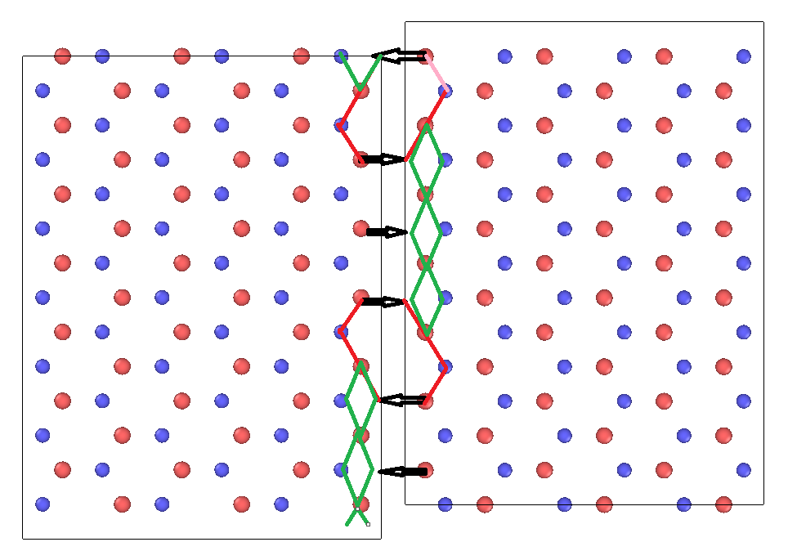
44484448….

Slide 12
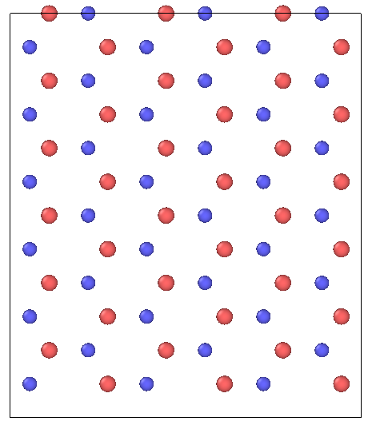
4484448…

Slide 13
Codes
Defined the unit cell using ASE library (python module)
Defined the replication number for x and y direction
Y direction replication from number of tetragon and octagon
X direction is user’s choice
Then mirrored the structure to create a mirror boundary
Add atoms near boundary to create the specified defect at boundary
Stich the original and mirrored structure and create the final structure

Slide 14
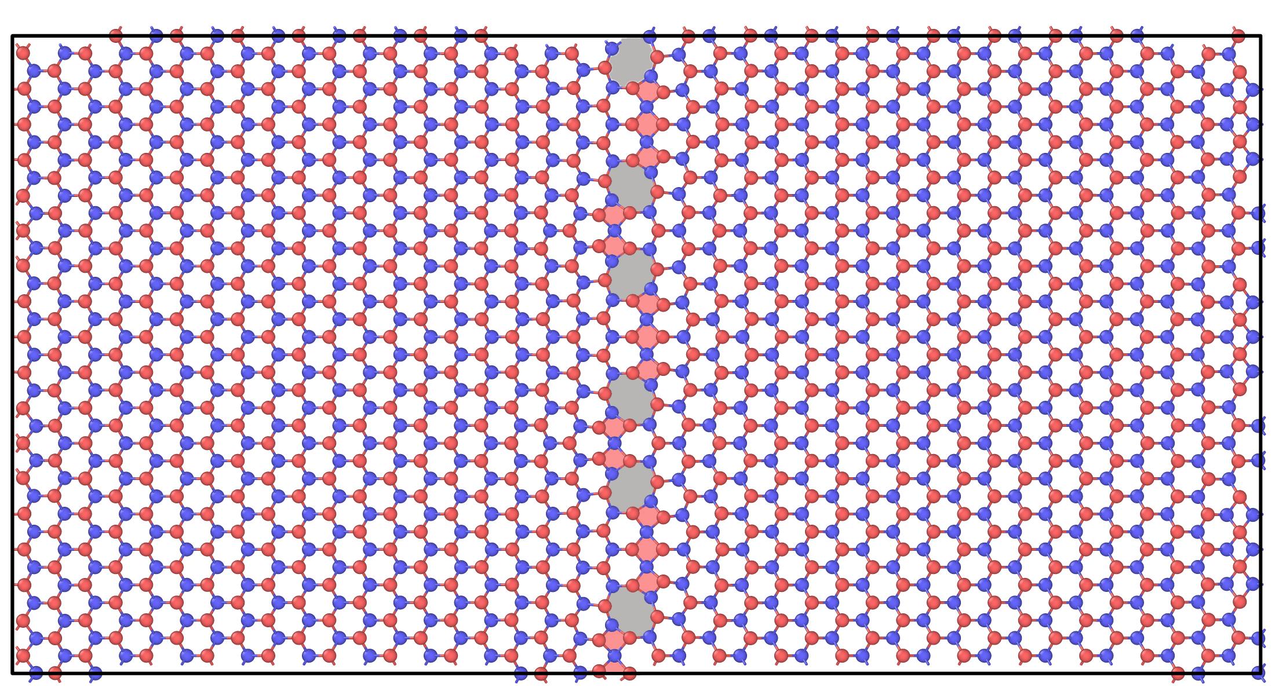
Created using my Code

Slide 15
Thank You

